Slide 1
Powerful Transformations: Strengthening, Evaluating, and Funding The Impact of Youth Organizing on Individual Young People
March 21, 2017

Slide 2
FCYO Capacity Building Projects
Goals:
Provide technical assistance to a cohort of 8-10 groups
Develop lessons and tools for the field
Past Initiatives:
Financial Management
Digital Organizing

Slide 3
More groups incorporating academic and social/emotional supports
Roots Initiative Toolkit: https://fcyo.org/resources/roots-initiative-toolkit
Leadership Pipeline Toolkit: https://fcyo.org/resources/regenerations-leadership-pipeline-toolkit
Healing Support and Transformation Webinar: https://fcyo.org/resources/healing-support-and-transformation-supporting-young-peoples-needs-while-organizing
Data on Youth Organizing: https://fcyo.org/resources/ops-11-building-transformative-leadership-data-on-the-impacts-of-youth-organizing
FCYO research on funding and messaging
Reaching youth funders has been hard
Key Question: With the right tools and supports can we reach more youth funders?
Notes:
Groups going great work supporting YP, but doung this and organiziung is hard, and groups not always able to reach those funders
Some YO groups have been successful really intgegrating YO and YD, and it has helped them access new funders
Did shared narrative research
Wanted to train groups to use those tools
Reaching YD funders is hard, YO groups often don’t speak their language
More used to talking about campaignsnthasn the process yp go through

Slide 4
Reaching YD Funders has been hard
YO groups often don’t have the language or data

Slide 5
FCYO Research
Campaign Strategies to unlock funding: https://fcyo.org/resources/campaign-strategies-to-unlock-foundation-funding-for-youth-organizing
Findings:
There are common characteristics of audiences who can be persuaded to fund youth organizing strategies
There are common characteristics of audiences who cannot be persuaded to fund youth organizing strategies
The messaging tested well with youth organizers – and there is a need to train on implementation
To be persuaded to fund youth organizing, funders need to hear both from their peers and from young people
Messages need to be emotionally attuned to the target audience
There are specific storytelling elements that funders need to hear to understand the power of youth organizing

Slide 6
Goals
To assist youth organizing groups in understanding, strengthening, and measuring how they support young people’s social/emotional, academic, and basic needs as they organize.
To increase the capacity of youth organizing groups to reach new foundation funders, especially those funders that focus on outcomes for individual young people.

Slide 7
Project Components
Cohort of 8-10 groups
Two organizational leaders to participate in all activities
Initial assessment
Two-day kick off training - June 5-6
8 web based trainings
Online evaluation tool
12-15 hours of one-on-one coaching on fundraising plan
$10K Grant

Slide 8
Pt 1. Understanding Strengthening and Assessing Youth Supports
Assessing how groups already support youth leaders, sharing practices
Connecting practices to research on youth development and social emotional learning
Developing an individual theory of change
Utilizing on online evaluation tool

Slide 9
Pt 2. Reaching New Funders
Learning from FCYO’s research on funding and messaging
Learning from funders and youth organizers
Coaching to develop a fundraising plan

Slide 10
Evaluation Support
Topic | Venue | Date
Social Emotional Learning (SEL) outcomes and positive youth development practices | 2 Day In-Person | May 2017
Creating research-based logic models | 1:1 Support | June –July 2017
Launching Your Study with Youth Development Impact Learning System (YDiLS | Webinar | August 2017
Setting up the YDiLS | 1:1 support | September 2017
Pre-Data Making Meaning Session | Webinar | October 2017
Launching your Post YDiLS | Webinar | May 2018
Post-Data Making Meaning Session: What Have We Learned? What More Do We Need to Learn? | In-Person + 1:1 Feedback | June/July 2018
Notes:
Sally, when are we going to develop the tool and vet this with the participants????????? I say in April session?
IT’S NOT DECIDED…. I THINK WE SHOULD SEE HOW IT GOES AND SEE IF WE NEED TO DO IT AS PART OF PILOT OR AS RESULT OF PILOT.
ISN’T THE POST-DATA ONE TOO SOON? SINCE MOST FOLKS WILL LIKELY COLLECT POST IN JUNE? AND WE HAVEN’T VETTED THIS SCHEDULE WITH HIVE EITHER….

Slide 11
Evaluation Support
Topic | Venue | Date
Social Emotional Learning (SEL) outcomes and positive youth development practices | 2 Day In-Person | May 2017
Creating research-based logic models | 1:1 Support | June –July 2017
Launching Your Study with Youth Development Impact Learning System (YDiLS | Webinar | August 2017
Setting up the YDiLS | 1:1 support | September 2017
Pre-Data Making Meaning Session | Webinar | October 2017
Launching your Post YDiLS | Webinar | May 2018
Post-Data Making Meaning Session: What Have We Learned? What More Do We Need to Learn? | In-Person + 1:1 Feedback | June/July 2018
Notes:
Sally, when are we going to develop the tool and vet this with the participants????????? I say in April session?
IT’S NOT DECIDED…. I THINK WE SHOULD SEE HOW IT GOES AND SEE IF WE NEED TO DO IT AS PART OF PILOT OR AS RESULT OF PILOT.
ISN’T THE POST-DATA ONE TOO SOON? SINCE MOST FOLKS WILL LIKELY COLLECT POST IN JUNE? AND WE HAVEN’T VETTED THIS SCHEDULE WITH HIVE EITHER….

Slide 12


Discuss Youth Development Practices Driving SEL
Short-Term Social-Emotional Learning Outcomes
Practices
Youth Engagement
+ relationships (staff & peer)
Youth interest & experience
High expectations
Youth decision-making
Peer Engagement
Group process
Support risk-taking
Ongoing reflection
Goal Management
Youth set and manage individual & group goals
Growth mindset
Staff Engagement
PYD practices to promote staff development
Community of learners
Long-term Outcomes
Thriving Youth
Positive Behavior
Reduced Risk Behavior
Academic Performance/ College Readiness
Workforce Readiness
Contribution
Academic
Self-Efficacy
Social Skills
Positive
Identity
Self-
Management
Social Capital

Slide 13
Evaluation Support
Topic | Venue | Date
Social Emotional Learning (SEL) outcomes and positive youth development practices | 2 Day In-Person | May 2017
Creating research-based logic models | 1:1 Support | June –July 2017
Launching Your Study with Youth Development Impact Learning System (YDiLS | Webinar | August 2017
Setting up the YDiLS | 1:1 support | September 2017
Pre-Data Making Meaning Session | Webinar | October 2017
Launching your Post YDiLS | Webinar | May 2018
Post-Data Making Meaning Session: What Have We Learned? What More Do We Need to Learn? | In-Person + 1:1 Feedback | June/July 2018
Notes:
Sally, when are we going to develop the tool and vet this with the participants????????? I say in April session?
IT’S NOT DECIDED…. I THINK WE SHOULD SEE HOW IT GOES AND SEE IF WE NEED TO DO IT AS PART OF PILOT OR AS RESULT OF PILOT.
ISN’T THE POST-DATA ONE TOO SOON? SINCE MOST FOLKS WILL LIKELY COLLECT POST IN JUNE? AND WE HAVEN’T VETTED THIS SCHEDULE WITH HIVE EITHER….

Slide 14
Evaluation Support
Topic | Venue | Date
Social Emotional Learning (SEL) outcomes and positive youth development practices | 2 Day In-Person | May 2017
Creating research-based logic models | 1:1 Support | June –July 2017
Launching Your Study with Youth Development Impact Learning System (YDiLS) | Webinar | August 2017
Setting up the YDiLS | 1:1 support | September 2017
Pre-Data Making Meaning Session | Webinar | October 2017
Launching your Post YDiLS | Webinar | May 2018
Post-Data Making Meaning Session: What Have We Learned? What More Do We Need to Learn? | In-Person + 1:1 Feedback | June/July 2018
Notes:
Sally, when are we going to develop the tool and vet this with the participants????????? I say in April session?
IT’S NOT DECIDED…. I THINK WE SHOULD SEE HOW IT GOES AND SEE IF WE NEED TO DO IT AS PART OF PILOT OR AS RESULT OF PILOT.
ISN’T THE POST-DATA ONE TOO SOON? SINCE MOST FOLKS WILL LIKELY COLLECT POST IN JUNE? AND WE HAVEN’T VETTED THIS SCHEDULE WITH HIVE EITHER….

Slide 15


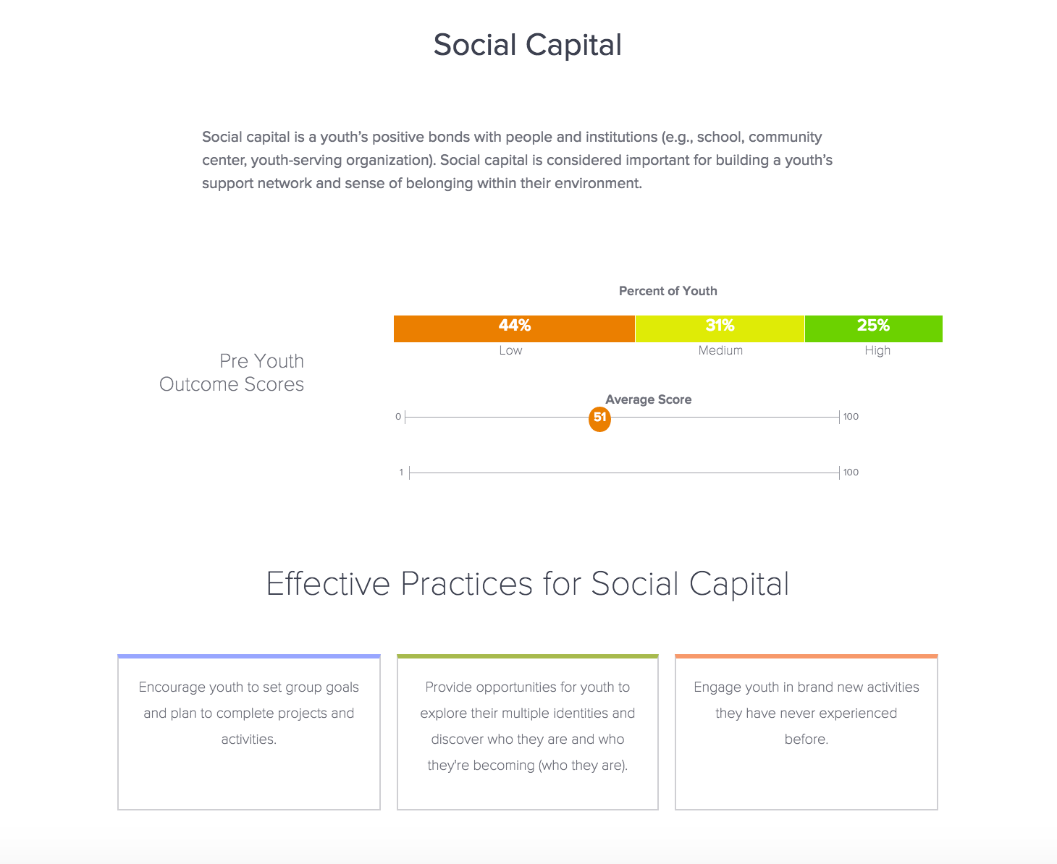
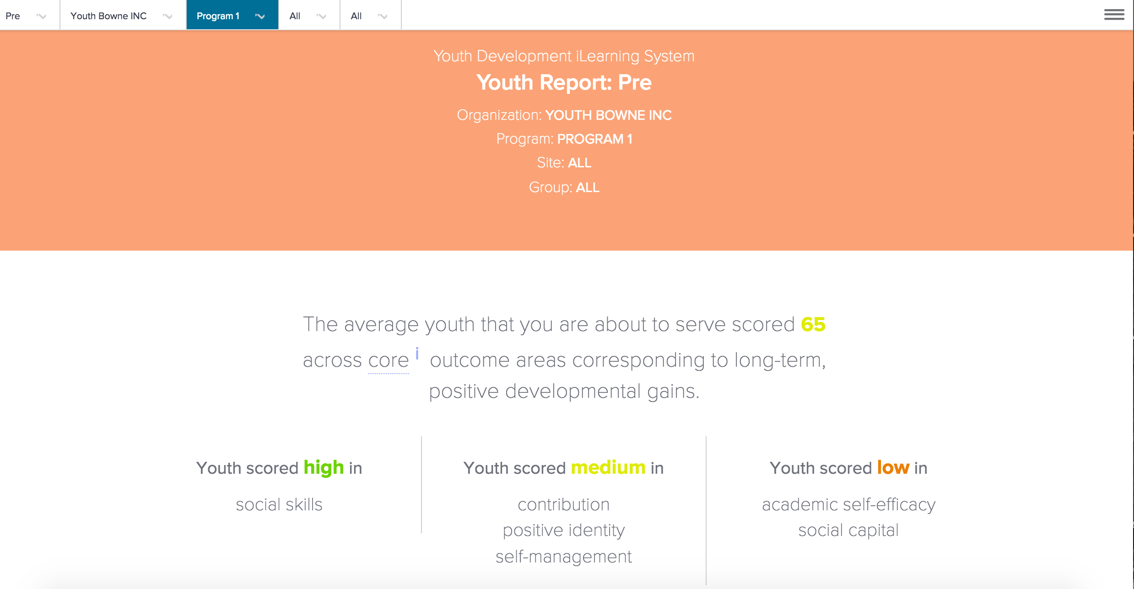
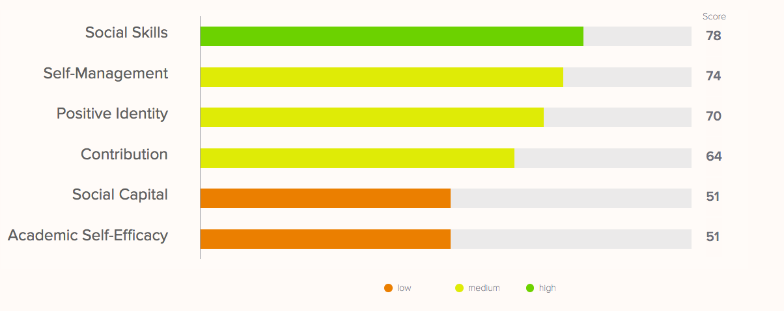
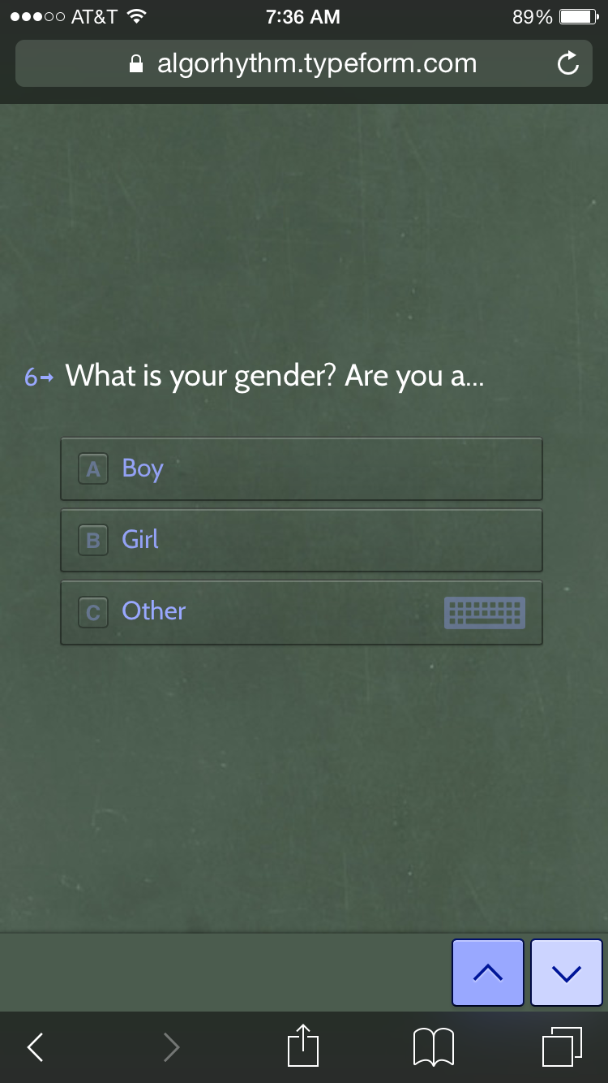
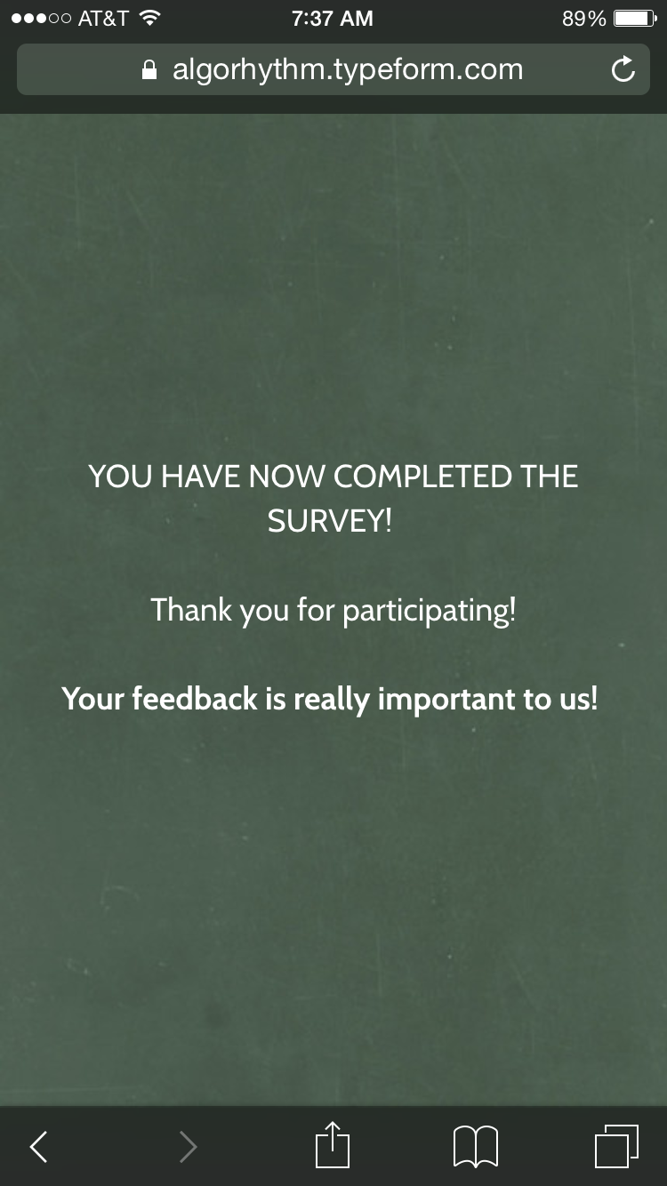
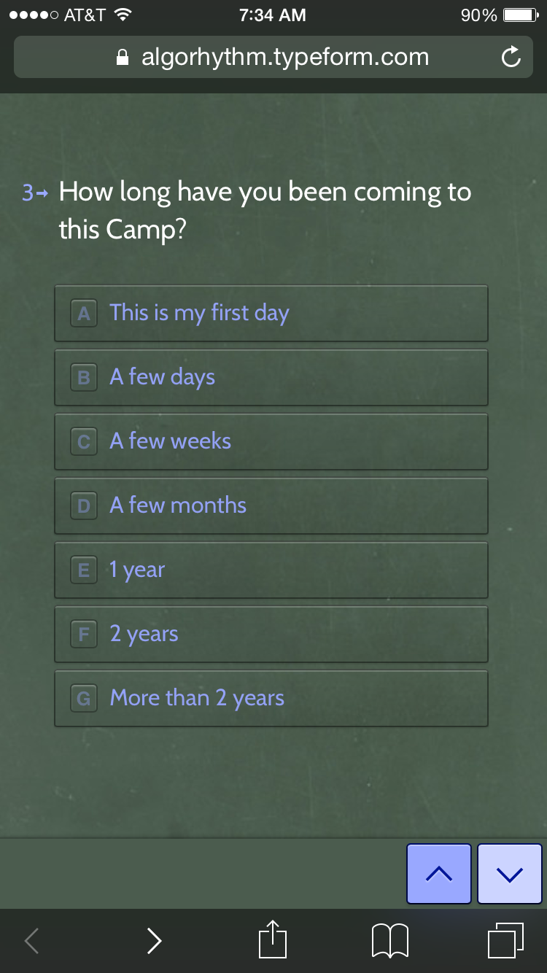
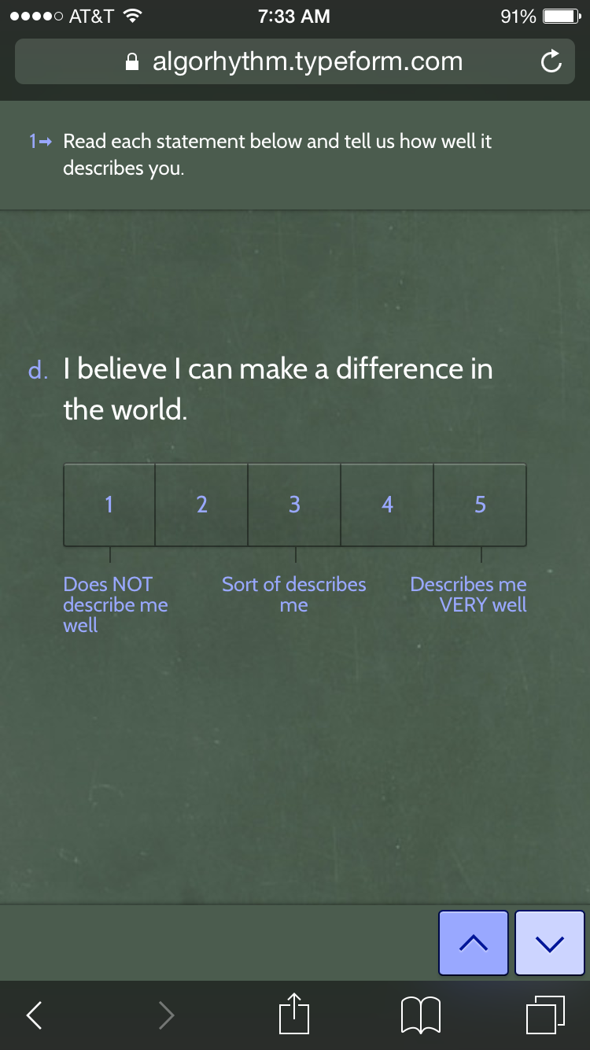

YD iLearning System: Youth And Adult Surveys
Pre-Survey Insights
Notes:
Then we used the YDiLS to measure our practices and outcomes.
This is an online software that is very low cost and allows you to launch surveys to both you and adults….

Slide 16
Evaluation Support
Topic | Venue | Date
Social Emotional Learning (SEL) outcomes and positive youth development practices | 2 Day In-Person | May 2017
Creating research-based logic models | 1:1 Support | June –July 2017
Launching Your Study with Youth Development Impact Learning System (YDiLS) | Webinar | August 2017
Setting up the YDiLS | 1:1 support | September 2017
Pre-Data Making Meaning Session | Webinar | October 2017
Launching your Post YDiLS | Webinar | May 2018
Post-Data Making Meaning Session: What Have We Learned? What More Do We Need to Learn? | In-Person + 1:1 Feedback | June/July 2018
Notes:
Sally, when are we going to develop the tool and vet this with the participants????????? I say in April session?
IT’S NOT DECIDED…. I THINK WE SHOULD SEE HOW IT GOES AND SEE IF WE NEED TO DO IT AS PART OF PILOT OR AS RESULT OF PILOT.
ISN’T THE POST-DATA ONE TOO SOON? SINCE MOST FOLKS WILL LIKELY COLLECT POST IN JUNE? AND WE HAVEN’T VETTED THIS SCHEDULE WITH HIVE EITHER….

Slide 17

Make Meaning of Data: Individually and as a Group
How can we use this information to improve our work?
How can we use this information to improve our work?
What does this tell us about our youth?
What doesn’t it tell us about our youth?
What more would we like to know?

Slide 18
Evaluation Support
Topic | Venue | Date
Social Emotional Learning (SEL) outcomes and positive youth development practices | 2 Day In-Person | May 2017
Creating research-based logic models | 1:1 Support | June –July 2017
Launching Your Study with Youth Development Impact Learning System (YDiLS) | Webinar | August 2017
Setting up the YDiLS | 1:1 support | September 2017
Pre-Data Making Meaning Session | Webinar | October 2017
Launching your Post YDiLS | Webinar | May 2018
Post-Data Making Meaning Session: What Have We Learned? What More Do We Need to Learn? | In-Person + 1:1 Feedback | June/July 2018
Notes:
Sally, when are we going to develop the tool and vet this with the participants????????? I say in April session?
IT’S NOT DECIDED…. I THINK WE SHOULD SEE HOW IT GOES AND SEE IF WE NEED TO DO IT AS PART OF PILOT OR AS RESULT OF PILOT.
ISN’T THE POST-DATA ONE TOO SOON? SINCE MOST FOLKS WILL LIKELY COLLECT POST IN JUNE? AND WE HAVEN’T VETTED THIS SCHEDULE WITH HIVE EITHER….

Slide 19
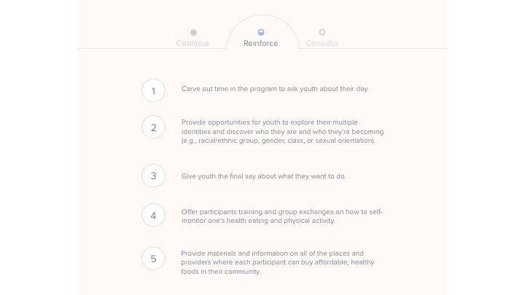
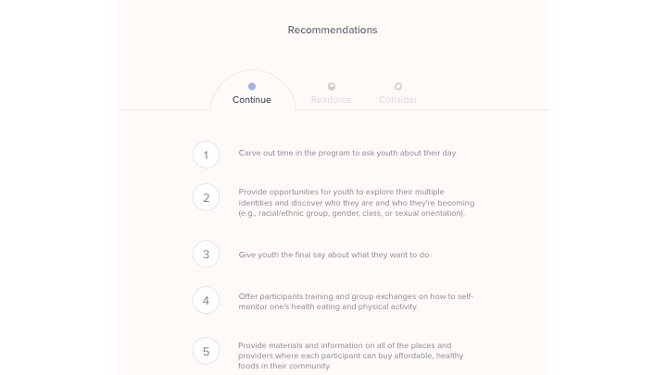
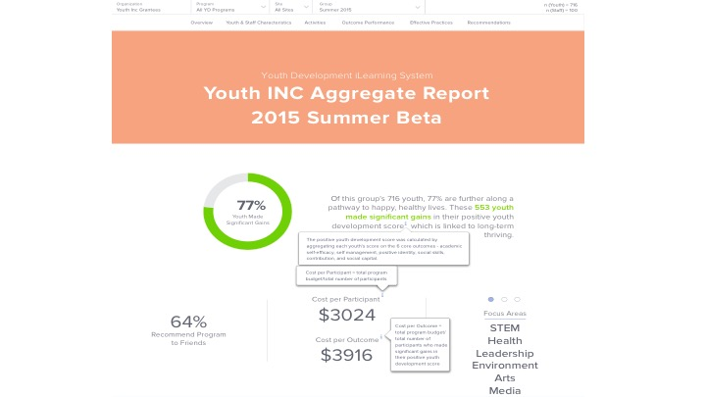
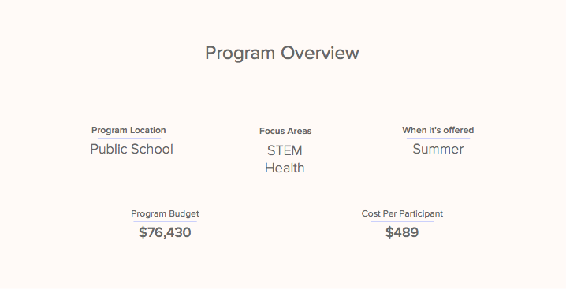
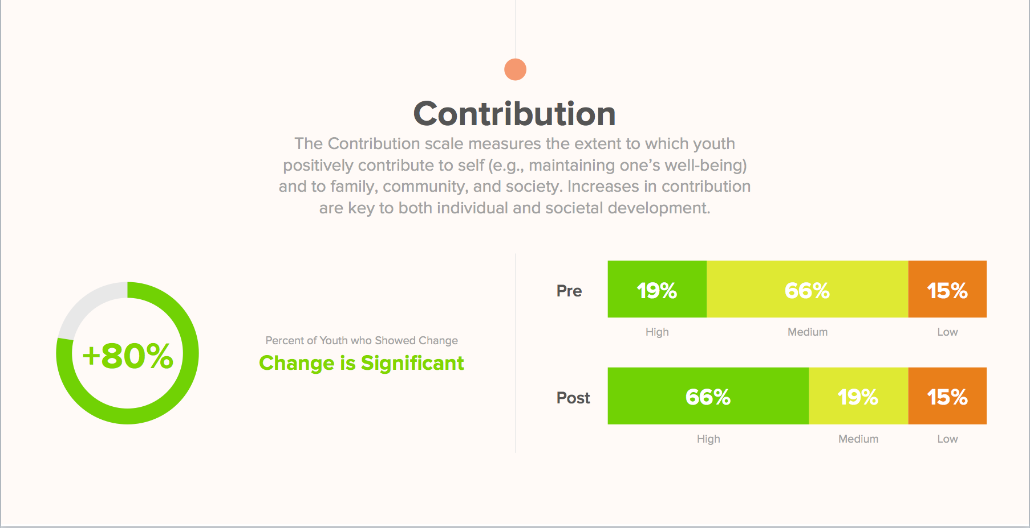
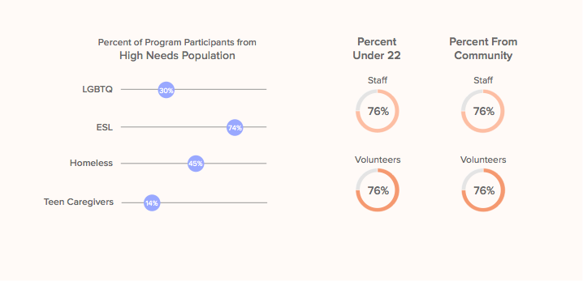
YD iLearning System Youth and Adult Surveys
Post-Survey Insights

Slide 20
Evaluation Support
Topic | Venue | Date
Social Emotional Learning (SEL) outcomes and positive youth development practices | 2 Day In-Person | May 2017
Creating research-based logic models | 1:1 Support | June –July 2017
Launching Your Study with Youth Development Impact Learning System (YDiLS) | Webinar | August 2017
Setting up the YDiLS | 1:1 support | September 2017
Pre-Data Making Meaning Session | Webinar | October 2017
Launching your Post YDiLS | Webinar | May 2018
Post-Data Making Meaning Session: What Have We Learned? What More Do We Need to Learn? | In-Person + 1:1 Feedback | June/July 2018
Notes:
Sally, when are we going to develop the tool and vet this with the participants????????? I say in April session?
IT’S NOT DECIDED…. I THINK WE SHOULD SEE HOW IT GOES AND SEE IF WE NEED TO DO IT AS PART OF PILOT OR AS RESULT OF PILOT.
ISN’T THE POST-DATA ONE TOO SOON? SINCE MOST FOLKS WILL LIKELY COLLECT POST IN JUNE? AND WE HAVEN’T VETTED THIS SCHEDULE WITH HIVE EITHER….

Slide 21

Making Meaning of Post Data: Individually and as a group
Discuss “What have we learned? And, what more do we need to know about Youth Organizing
What is missing?
What other measures exist?
What types of methods would work best to capture this data?

Slide 22
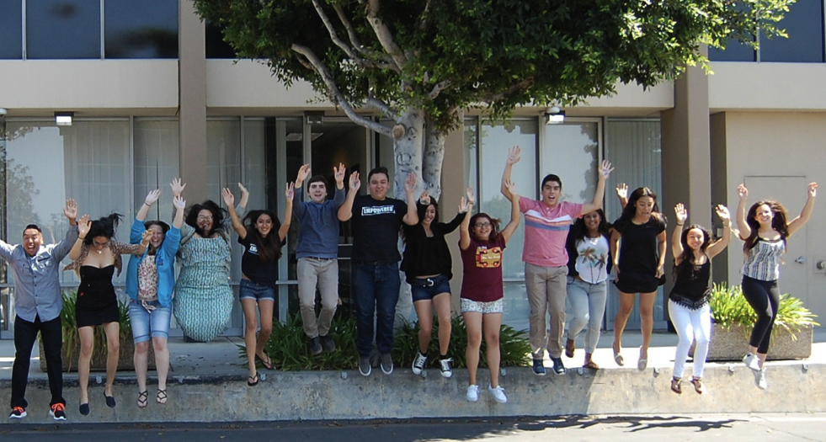


EXCERPTS FROM:
Campaign Strategies to Unlock
Foundation Funding for Youth Organizing

Slide 23
Summary: Findings
There are common characteristics of audiences who can be persuaded to fund youth organizing strategies
There are common characteristics of audiences who cannot be persuaded to fund youth organizing strategies
The messaging tested well with youth organizers – and there is a need to train on implementation
To be persuaded to fund youth organizing, funders need to hear both from their peers and from young people
Messages need to be emotionally attuned to the target audience
There are specific storytelling elements that funders need to hear to understand the power of youth organizing
Notes:
To be displayed if someone asks to see a summary of the findings.

Slide 24
Finding 1:
There are common characteristics of audiences who can be persuaded to fund youth organizing strategies
Funders who can be persuaded:
See young people as civic actors who are powerful and engaged, not passive
Recognize young people as assets and believe in lifting up their voices
May be primarily concerned with individual outcomes and favor the “asset” approach to youth
Have some diversity in their investment portfolio
“I saw FCYO present a spectrum from traditional service provision to youth organizing on the other end. It was helpful because work is needed on all points of spectrum. If we’re on service provision side, fine, but there is merit in being deliberate and finding opportunities to move toward youth organizing.”
    In-Depth Interview with Education funder
Deficit
Asset
Voice
Power
Notes:
Taj

Slide 25
Finding 4:
To be persuaded to fund youth organizing, funders need to hear both from their peers and from young people
How 30 young people improved educational opportunities for 300,000 students
When Luis Perez entered Washington High School* in Las Vegas as a 9th grader, he dreamed of being the first person in his family to go to college, but he soon discovered that his school didn’t offer the requisite courses for admission into a state college. He shared his disappointment with a friend, Adriana Gutierrez, who invited him to join an organization called Students United* that was working to improve schools in the district. Luis was reluctant to join because he didn’t see how students could do anything about the problem, but Adriana was very persuasive.
Working in coalition with teachers and parents from high schools across the district, they organized and campaigned to make college-prep curriculum the default coursework for all high school students in the Clark County School District.
-excerpt from Youth Campaign Victory Story
Why this works?
The youth perspective “gives better flavor and sense of what youth engagement looks and feels like and what it can accomplish.” – Funder
Personal details make the story authentic.
Funders appreciated seeing that adults were also involved, but have an appetite for more details.
The story shows how a small number of youth can create impact at scale.
Notes:
Scott

Slide 26
Messages need to be emotionally attuned to the target audience
Finding 5:
Lead with the outcomes that funders are looking to accomplish – rather than youth organizing
“Young people working together to improve their community” is a stronger description than “youth organizing”
Communicate the “two-for-one” investment – individual skills building and systemic change
“What resonates the most is individual growth and community or policy change happening simultaneously. Individual growth is important but systemic change has to take place.”
    Survey respondent
Notes:
Carolyn
Lead with the why, not the how
Given funders’ limited or flawed understanding of youth organizing, leading with the term “youth organizing” rather than the outcomes funders are looking to accomplish is emotionally incongruent
“Young people working together to improve their community” is a much better description at the beginning and “youth organizing” can be introduced later
The idea of the “two-for-one” investment resonates with funders, so we must show both individual capacity building and the ability to address larger systemic change

Slide 27
Criteria
Well established youth organizing program
Intentional leadership development and supports for youth leaders
Have ability and desire to strengthen supports for young people, engage in eval, and develop new messages for funders
Have the ability and desire to participate in all cohort activities
Have at least two full time staff or the equivalent

Slide 28
Application Process
Online Map
Cover Page
Narrative
Attachments
Submission:
Create one compressed or zipped folder
Upload this folder through a secure Dropbox link
Email your Cover Letter

Slide 29
Narrative
1) How do you currently support the leadership and holistic development of your members? Describe your leadership development program and any other services or supports you offer to your members. If you do offer supports do you do it internally or through partnerships with other organizations? How many young people are involved?
2) How do you currently measure or evaluate the impact of your work on your members? Do you do a formal evaluation? Do they complete any kind of survey?
3) How is your youth organizing program currently funded? How much of your funding comes from organizing funders, issue based funders, youth development funders, community foundations, etc…? What has been your experience (successes and failures) reaching out to youth development and other funders not focused on organizing?
4) Who specifically from your organization would participate in this program? What do you want to get out of it and how would this strengthen your organization?

Slide 30
Questions and Answers

